Slide 1
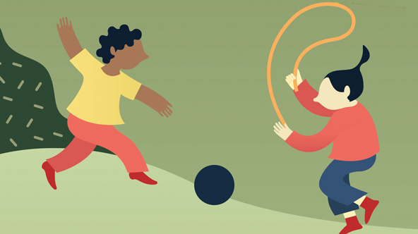
Glasgow Data Catalogue
Simulation of Physical Activity of Primary School Children in Glasgow City
Image Credit: Stanford Social Innovation Review

